Slide 1

Leveraging Deep Learning and Multimodal Data for Enhanced Flood Forecasting
Guided By: Submitted By:
Mrs. Sthitapragyan Mohanty Ranjendra Mandal(2212100128)
(Faculty, SCS, OUTR) Subham Ranjan Sahoo (2212100081)

Slide 2
Content
Overview
Brainstorming objectives
Rules
Brainstorming activities
Summarise
Next Steps

Slide 3
Introduction
Increased Floods: Climate change leads to more frequent and intense floods.
Flood segmentation aims to identify flooded areas in satellite imagery, essential for disaster management and mitigation.
Accurate segmentation helps in understanding the extent of flood damage, planning rescue operations, and minimizing risks.
Traditional methods like thresholding and region-based approaches are insufficient for complex and high-dimensional satellite data.
Useful in real-time flood detection, urban planning, and environmental monitoring, providing actionable insights for disaster response.

Slide 4
Literature Review
S.no | Year | Technique used | Finding
1. | 2024 | Deep learning-based semantic image segmentation using U-Net and DeepLabv3 architectures | DeepLabv3 outperformed U-Net with 92.16% accuracy, while U-Net achieved 89.74% accuracy, in flood image segmentation.
2. | 2024 | Deep learning techniques: CNN with attention mechanism and U-Net with MobileNet base for flood detection and segmentation. | CNN model achieved 98% accuracy and U-Net with MobileNet base achieved 90% accuracy in flood detection and segmentation.
3. | 2024 | Deep learning-based U-Net architecture for semantic segmentation of aerial and satellite images for flood detection. | The U-Net model achieved an Intersection over Union (IoU) score of 0.85, surpassing traditional methods in flood detection accuracy.
4. | 2024 | The voting classifier, combining Random Forest and Gradient Boosting algorithms, leveraging turbidity, gauge height, and discharge data to predict floods. | Achieves approximately 99% accuracy
5. | 2024 | Implements and compares various supervised machine learning algorithms (Logistic Regression, Random Forest, XGB, ExtraTree, LGBM, and CatBoost classifiers) for flood prediction analysis. | XGB and CatBoost classifiers outperform others with accuracy rates of 93.5% and 92.8%, respectively.
6. | 2024 | Deep learning-based U-Net architecture for semantic segmentation of aerial and satellite images for flood detection. | The U-Net model achieved an Intersection over Union (IoU) score of 0.85, surpassing traditional methods in flood detection accuracy.
7. | 2020 | Recurrent Neural Network (RNN) and comparison with alternative mathematical and regression models for flood prediction and water level prediction. | The proposed Recurrent Neural Network (RNN) model achieved 95.6% accuracy in flood prediction and 94.2% accuracy in water level prediction
8. | 2019 | Deep Convolutional Neural Network (DCNN) | Deep learning-based image classification with segmentation improved flood monitoring accuracy.
.

Slide 5
Problem Statement
Complex Satellite Data: Traditional methods fail to handle diverse textures, scales, and high-resolution imagery effectively.
Traditional Technique Limitations: Poor adaptability to noise, illumination changes, and large datasets.
Real-time Needs: High demand for real-time segmentation for disaster response
Class Imbalance: Underrepresentation of flood-related classes in datasets impacts accuracy.
Feature Extraction Challenges: Traditional methods lack the ability to identify complex flood patterns.
Struggle with real-time high-resolution data.
Solution: Deep learning autonomously learns hierarchical representations for better accuracy.

Slide 6
Objective
Enhance the accuracy and efficiency of flood segmentation in satellite images.
Address the limitations of traditional methods that struggle with high-resolution and complex data.
Use U-Net deep learning to automatically identify patterns and features in raw data.
Provide pixel-level segmentation of satellite images for effective disaster management.

Slide 7
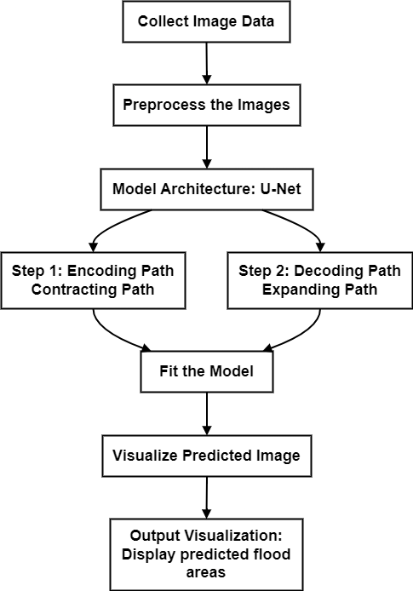
Flowchart

Slide 8
Dataset
Source: Kaggle satellite imagery datasets.
Key Attributes: High-resolution images of flood-prone areas.
https://www.kaggle.com/datasets/faizalkarim/flood-area-segmentation

Slide 9
Data Preprocessing
Steps:
Resize images to 128x128 pixels.
Normalize pixel values using min-max scaling.
Convert hexadecimal mask colors to RGB format.
Augmentation: Improves model generalization.

Slide 10
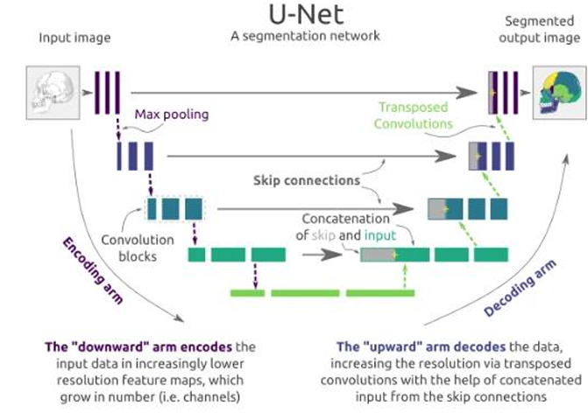
Model Architecture Diagram

Slide 11
Model Architecture Description
Structure:
U-shaped design with two parts:
Encoder: Extracts features (down-sampling).
Decoder: Restores resolution (up-sampling).
Skip Connections:
Link encoder and decoder to retain spatial details.
Loss Functions:
Dice Loss: Measures overlap accuracy.
Optimizer:
Uses Adam for adaptive learning rate.
Output:
Predicts and segments flood-prone areas in satellite images.

Slide 12
Data Split
Training: 85%.
Testing: 15%.

Slide 13
Model Implementation
Segment satellite images for classes like buildings, roads, vegetation, and water using U-Net.
preprocessed into 128x128 patches, scaled and split.
Encoder: Extracts features with convolution and pooling layers.
Decoder: Upsamples features using transposed convolutions; skip connections preserve spatial details.
Dropout used for overfitting control.
Dice Loss:Measures overlap between predicted and actual segmentation masks which Helps in achieving precise boundaries.
Accuracy:Measures the percentage of correctly classified pixels.
Visual Results:Predicted segmentation maps aligned closely with ground truth.

Slide 14
Experimental Results
Accuracy: On the test dataset, the model correctly identified 91.77% of the pixels and achieved 88.5% accuracy during validation (testing on unseen data).
IoU (Intersection over Union): Measures how well the predicted areas overlap with the actual areas for each class. Higher IoU means better segmentation accuracy.
Visual Outcomes:The U-Net model was able to accurately segment areas in satellite images, such as buildings and roads.

Slide 15
Applications
The model can segment images for various uses:
Disaster response: Identifying flooded areas for quick action.
Environmental monitoring: Observing land changes over time.
Urban planning: Mapping buildings, roads, and vegetation for city management.
Disaster management and flood impact mitigation.
Observation: Despite some minor mistakes, the model effectively separated classes, showing potential for real-world use.
Impact: Supports real-time decision-making and risk assessment.

Slide 16
Future Scope
Advanced Models: Develop attention-based or transformer architectures for better segmentation.
Transfer Learning: Use pre-trained models for improved performance with minimal data.
Data Fusion: Combine optical and SAR data for greater segmentation accuracy.
Large Dataset Scaling:: Adapt U-Net for larger, high-resolution datasets.
Real-Time Processing: Enable real-time segmentation for disaster response.
Extend use to environmental monitoring and urban planning.
integrating multimodal data

Slide 17
Conclusion
U-Net achieves excellent segmentation accuracy (91.77%), making it reliable for flood detection and disaster management.
Its encoder-decoder structure and skip connections ensure precise feature extraction and localization.
Requires large datasets, computational power, and quality preprocessing to address image variability.
Useful for real-world applications like flood response, land mapping, and environmental monitoring.
Enhancements include multimodal data integration and automated labelling for improved adaptability and efficiency.

Slide 18
Conclusion
[1] R. Dahiya, M. K. Ojha, S. Saini, and S. Ratna, "Satellite Image Segmentation Using U-Net," (2024) 15th International Conference on Computing Communication and Networking Technologies (ICCCNT), IIT Mandi, India.
DOI: 10.1109/ICCCNT61001.2024.10726242.
[2]Ronneberger, O., Fischer, P., & Brox, T. (2023). U-Net: Convolutional Networks for Biomedical Image Segmentation. In International Conference on Medical Image Computing and Computer-Assisted Intervention (MICCAI) (pp. 234-241).
[3]Zhu, W., & Chen, X. (2022). A Review of Flood Detection and Prediction Based on Remote Sensing. Remote Sensing, 12(12).
[4]Zhang, X., & Zhu, H. (2021). Flood Prediction with Machine Learning Models Using Remote Sensing Data: A Review. IEEE Access, 8, 114978-114991. DOI: 10.1109/ACCESS.2020.3008139

Slide 19
THANK YOU

